Slide 1
Understanding the Anatomy of an Android Application

Slide 2
Overview
Master important terminology
Learn what the application Context is and discover how to use it
Accomplish tasks with activities and explore the Activity lifecycle
Determine how to improve the overall structure of an application using fragments
Manage Activity transitions and organize navigation with intents
Discover the usefulness of services
Investigate other uses for intents

Slide 3
Mastering Important Android Terminology
Context
  android.content.Context
Activity
  android.app.Activity
Fragment
  android.app.Fragment
Intent
  android.content.Intent
Service
  android.app.Service
Notes:
Context
The context is the central command center for an Android application. Most application-specific functionality can be accessed or referenced through the context. The Context class (android.content.Context) is a fundamental building block of any Android application and provides access to application-wide features such as the application’s private files and device resources as well as system-wide services. The application-wide Context object is instantiated as an Application object (android.app.Application).
Activity
An Android application is a collection of tasks, each of which is called an activity. Each activity within an application has a unique task or purpose. The Activity class (android.app.Activity) is a fundamental building block of any Android application, and most applications are made up of several activities. Typically, this purpose is to handle the display of a single screen, but thinking only in terms of “an activity is a screen” is too simplistic. An Activity class extends the Context class, so it also has all of the functionality of the Context class.
Fragment
An activity has a unique task or purpose, but it can be further componentized; each component is called a fragment. Each fragment within an application has a unique task or purpose within its parent activity. The Fragment class (android.app.Fragment) is often used to organize activity functionality in such a way as to allow a more flexible user experience across various screen sizes, orientations, and aspect ratios. A fragment is commonly used to hold the code and screen logic for placing the same user interface component in multiple screens, which are represented by multiple Activity classes.
Intent
The Android operating system uses an asynchronous messaging mechanism to match task requests with the appropriate activity. Each request is packaged as an intent. You can think of each such request as a message stating an intent to do something. Using the Intent class (android.content.Intent) is the primary method by which application components such as activities and services communicate with one another.
Service
Tasks that do not require user interaction can be encapsulated in a service. A service is most useful when the operations are lengthy (offloading time-consuming processing) or need to be done regularly (such as checking a server for new mail). Whereas activities run in the foreground and generally have a user interface, the Service class (android.app.Service) is used to handle background operations related to an Android application. The Service class extends the Context class.

Slide 4
The Application Context
Central location for all top-level application functionality
Used to manage application-specific configuration details as well as application-wide operations and data
Access settings and resources shared across multiple Activity instances

Slide 5
Retrieving the Application Context
Context context = getApplicationContext();
Notes:
You can retrieve the Context for the current process using the getApplicationContext() method, found in common classes such as Activity and Service.

Slide 6
Using the Application Context
Retrieving application resources such as strings, graphics, and XML files
Accessing application preferences
Managing private application files and directories
Retrieving uncompiled application assets
Accessing system services
Managing a private application database (SQLite)
Working with application permissions
Notes:
After you have retrieved a valid application Context object, it can be used to access application-wide features and services, including . . .

Slide 7
Warning!
Because the Activity class is derived from the Context class, you can sometimes use this instead of retrieving the application Context explicitly. However, don’t be tempted to just use your Activity Context in all cases because doing so can lead to memory leaks.

Slide 8
Retrieving Application Resources
String greeting = getResources().getString(R.string.hello);
Notes:
You can retrieve application resources using the getResources() method of the application Context. The most straightforward way to retrieve a resource is by using its resource identifier, a unique number automatically generated within the R.java class.

Slide 9
Accessing Application Preferences
getSharedPreferences()
The SharedPreferences class can be used to save simple
application data, such as configuration settings or persistent application state information.
Notes:
You can retrieve shared application preferences using the getSharedPreferences() method of the application Context. The SharedPreferences class can be used to save simple application data, such as configuration settings or persistent application state information.

Slide 10
Accessing Application Files and Directories
You can use the application Context to access, create, and manage application files and directories private to the application as well as those on external storage

Slide 11
Retrieving Application Assets
getAssets()
You can retrieve application resources using the getAssets() method of the application Context. This returns an AssetManager (android.content.res.AssetManager) instance that can then be used to open a specific asset by its name.
Notes:
You can retrieve application resources using the getAssets() method of the application Context.
This returns an AssetManager (android.content.res.AssetManager) instance that can then be used to open a specific asset by its name.

Slide 12
Performing Application Tasks with Activities
A simple game application might have the following five activities:
  Startup or splash screen
  Main menu screen
  Game play screen
  High scores screen
  Help/About screen
Notes:
Startup or splash screen
This activity serves as the primary entry point to the application. It displays the application name and version information and transitions to the main menu after a short interval.
Main menu screen
This activity acts as a switch to drive the user to the core activities of the application. Here users must choose what they want to do within the application.
Game play screen
This activity is where the core game play occurs.
High scores screen
This activity might display game scores or settings.
Help/About screen
This activity might display the information the user might need to play the game.

Slide 13
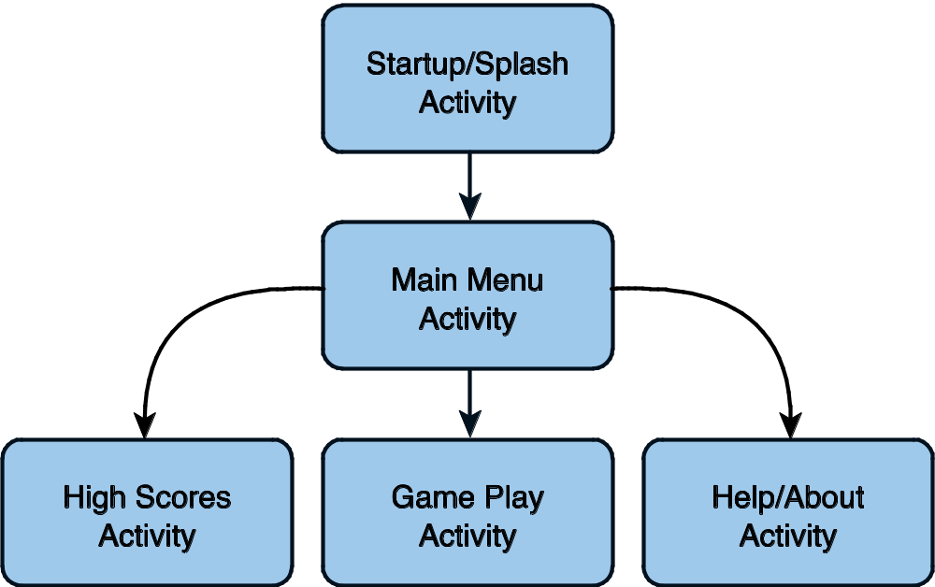
Performing Application Tasks with Activities
Notes:
A representation of how to perform the activities in the application.

Slide 14
Lifecycle of an Android Activity
Android apps can be multiprocess
Android allows multiple apps to run concurrently (provided memory and processing power are available)
Applications can have background behavior
Applications can be interrupted and paused when events such as phone calls occur
There can be only one active application visible to the user at a time—specifically, a single application Activity is in the foreground at any given time

Slide 15
Lifecycle of an Android Activity
Android keeps track of all Activity objects running by placing them on an Activity stack
The Activity stack is referred to as the “back stack”
When a new Activity starts, the Activity on the top of the stack (the current foreground Activity) pauses, and the new Activity pushes onto the top of the stack
When that Activity finishes, it is removed from the Activity stack, and the previous Activity in the stack resumes

Slide 16
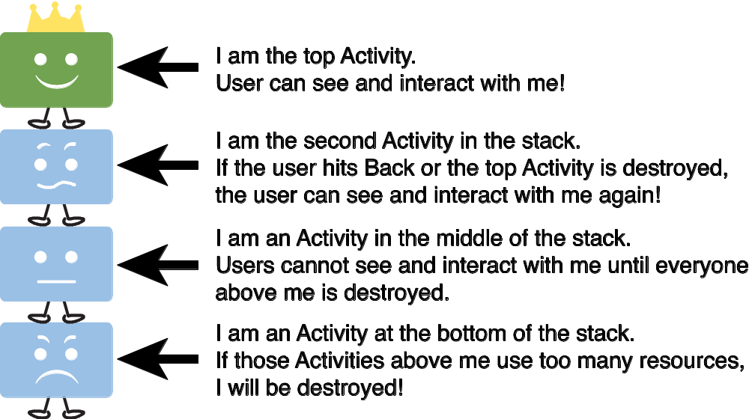
Lifecycle of an Android Activity
Notes:
The Activity stack.

Slide 17
Using Activity Callbacks to Manage App State and Resources
public class MyActivity extends Activity {
protected void onCreate(Bundle savedInstanceState);
protected void onStart();
protected void onRestart();
protected void onResume();
protected void onPause();
protected void onStop();
protected void onDestroy();
}
Notes:
Android applications are responsible for managing their state and their memory, resources, and data.
They must pause and resume seamlessly.
Understanding the different states within the Activity lifecycle is the first step in designing and developing robust Android applications.
These are the method stubs for the most important callbacks of the Activity class.

Slide 18
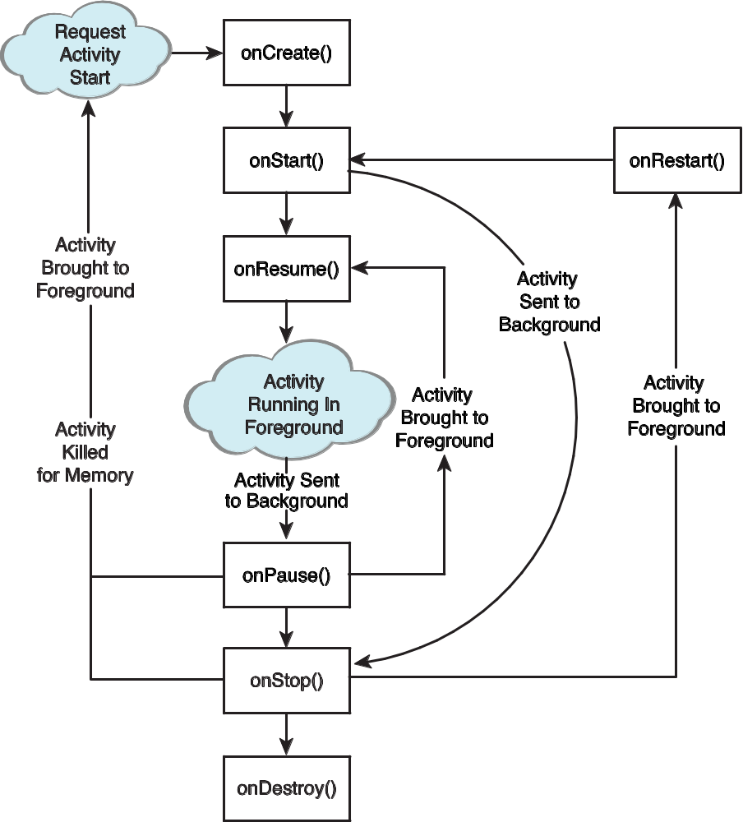
Lifecycle of an Android Activity
Notes:
Here is a visual representation of how Activity callback methods are related to one another.

Slide 19
Initializing Static Activity Data in onCreate()
When an Activity first starts, onCreate() is called
onCreate() has a single parameter
  a Bundle (null if newly started Activity)
If this Activity is a restarted Activity
  Bundle contains previous state information so that it can reinitiate
Perform setup (layout and data binding) in onCreate()
  Such as setContentView()

Slide 20
Initializing and Retrieving Activity Data in onResume()
When the Activity reaches the top of the stack and becomes the foreground process, onResume() is called
This is the most appropriate place to retrieve any instances of resources (exclusive or otherwise) that the Activity needs to run
These resources are the most process intensive, so we keep them around only while the Activity is in the foreground
The onResume() method is often the appropriate place to start audio, video, and animations

Slide 21
Stopping, Saving, and Releasing Activity Data in onPause()
When another Activity moves to the top of the stack, Activity is informed and pushed down the stack by onPause()
Stop audio, video, and animations started in onResume()
Deactivate resources such as database Cursor or other objects that should be cleaned up should your Activity be terminated
onPause() may be the last chance for the Activity to clean up and release any resources it does not need while in the background
Save uncommitted data in case your application does not resume
The system has a right to kill an Activity without further notice after calling onPause()
Save state information to Activity-specific preferences or application-wide preferences
Perform anything in onPause() in a timely fashion
  The new foreground Activity is not started until onPause() returns

Slide 22
Warning!
Any resources and data retrieved in onResume() should be released in onPause()! If they aren’t, some resources may not be cleanly released if the process is terminated!

Slide 23
Avoiding Activities Being Killed
If the Activity is killed after onPause(), the onStop() and onDestroy() methods will not be called
The more resources released by an Activity in the onPause() method, the less likely the Activity is to be killed while in the background without further state methods being called
Notes:
Under low-memory conditions, the Android operating system can kill the process for any Activity that has been paused, stopped, or destroyed.
This essentially means that any Activity not in the foreground is subject to a possible shutdown.
The act of killing an Activity does not remove it from the Activity stack.
Instead, the Activity state is saved into a Bundle object, assuming the Activity implements and uses onSaveInstanceState() for custom data, although some View data is automatically saved.
When the user returns to the Activity later, the onCreate() method is called again, this time with a valid Bundle object as the parameter.

Slide 24
Saving Activity State with onSaveInstanceState()
If an Activity is vulnerable to being killed by Android, you can save state info to a Bundle with onSaveInstanceState()
  This call is not guaranteed, so use onPause() for essential data commits
What is recommended?
  Save important data to persistent storage in onPause(), but use onSaveInstanceState() to start any data that can be used to rapidly restore the current screen to the state it was in (as the name of the method might imply)

Slide 25
Tip
You might want to use the onSaveInstanceState() method to store nonessential information such as uncommitted form field data or any other state information that might make the user’s experience with your application less cumbersome

Slide 26
Saving Activity State with onSaveInstanceState()
When this Activity is returned to later, this Bundle is passed in to the onCreate() method, allowing the Activity to return to the exact state it was in when the Activity paused
You can also read Bundle information after the onStart() callback using onRestoreInstanceState()
When the Bundle information is there, restoring the previous state will be faster and more efficient than starting from scratch

Slide 27
Destroying Static Activity Data in onDestroy()
When an Activity is being destroyed in the normal course of operation, the onDestroy() method is called
The onDestroy() method is called for one of two reasons
  The Activity completed its lifecycle voluntarily
  The Activity is being killed by the OS because it needs the resources (but still has the time to gracefully destroy the Activity)

Slide 28
Tip
isFinishing() returns false if the Activity has been killed
This method can be helpful in onPause() to know if the Activity is not going to resume right away
The Activity might still be killed in onStop() at a later time
You may be able to use this as a hint to know how much instance state information to save or permanently persist

Slide 29
Organizing Activity Components with Fragments
Android 3.0 introduced fragments
A Fragment is a chunk of user interface with its own lifecycle within an Activity
  Represented by the Fragment class (android.app.Fragment) and several supporting classes
A Fragment class instance must exist within an Activity instance (and its lifecycle)
A Fragment need not be paired with the same Activity class each time it’s instantiated

Slide 30
Organizing Activity Components with Fragments
Fragments are best illustrated by example
Consider an MP3 music player app
Following the one-screen-to-one-Activity rule
  List Artists Activity
  List Artist Albums Activity
  List Album Tracks Activity
  Show Track Activity
Fine for smartphone, but what about tablet?

Slide 31
Organizing Activity Components with Fragments
All four activities may fit on a single screen
  Column 1 displays a list of artists
    Selecting an artist filters the second column
  Column 2 displays a list of that artist’s albums
    Selecting an album filters the third column
  Column 3 displays a list of that album’s tracks
  Below all of the columns
    Display the artist, album, or track art and details

Slide 32
Organizing Activity Components with Fragments
We don’t want to build different activities for different-size devices
If you componentize your features and make four fragments, you can mix and match them on the fly
  Still having only one code base

Slide 33
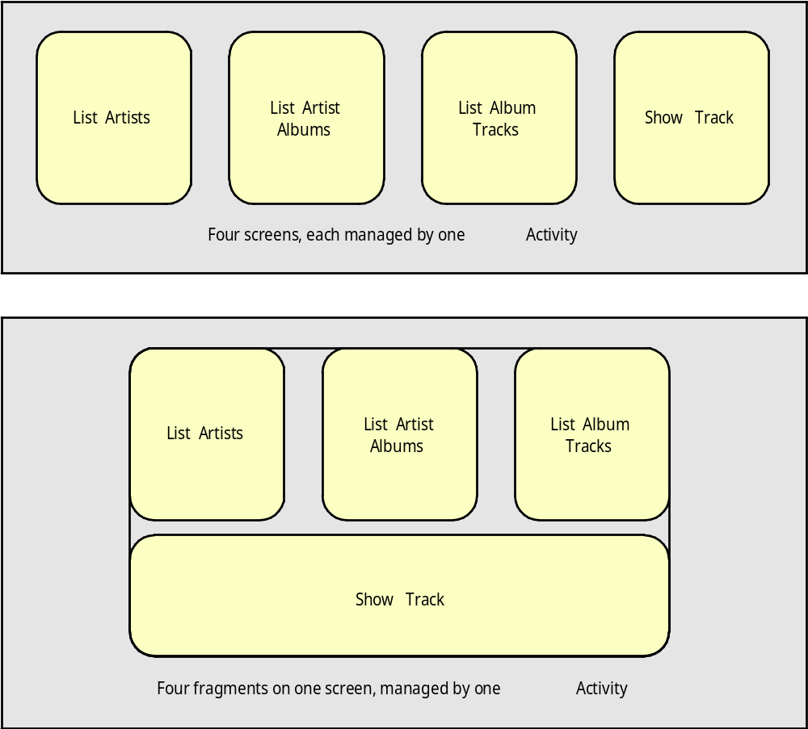
Organizing Activity Components with Fragments
Notes:
Here we see how fragments can improve application workflow flexibility.

Slide 34
Managing Activity Transitions with Intents
Users transition between a number of different Activity instances
Developers need to pay attention to the Activity lifecycle during these transitions
Ways to handle permanently discarded Activity transitions
  startActivity() and finish()
Ways to handle temporary transitions with plans to return
  startActivityForResult() and onActivityResult()
Notes:
Ways to handle permanently discarded Activity transitions
Some Activity instances—such as the application splash/startup screen—are shown and then permanently discarded when the main menu screen Activity takes over. The user cannot return to the splash screen Activity without relaunching the application. In this case, use the startActivity() and appropriate finish() methods.
Ways to handle temporary transitions with plans to return
Other Activity transitions are temporary, such as a child Activity displaying a dialog and then returning to the original Activity (which was paused on the Activity stack and now resumes). In this case, the parent Activity launches the child Activity and expects a result. For this, use the startActivityForResult() and onActivityResult() methods.

Slide 35
Transitioning between Activities with Intents
Android applications can have multiple entry points
A specific Activity can be designated as the main Activity to launch by default
Other activities might be designated to launch under specific circumstances
Notes:
Other activities might be designated to launch under specific circumstances
For example, a music application might designate a generic Activity to launch by default from the Application menu but also define specific alternative entry-point activities for accessing specific music playlists by playlist ID or artists by name.

Slide 36
Launching a New Activity by Class Name
You can start activities in several ways
The simplest method
  Use the Application Context object to call startActivity()
  startActivity() takes a single parameter, an Intent
An Intent (android.content.Intent) is an asynchronous message mechanism
  Used by Android to match task requests with the appropriate Activity or Service (launching it, if necessary) and to dispatch broadcast Intent events to the system at large

Slide 37
Launching a New Activity by Class Name
Example of Explicit Intent
startActivity(new Intent(getApplicationContext(),
MyDrawActivity.class));
Notes:
The following line of code calls the startActivity() method with an explicit Intent.
This Intent requests the launch of the target Activity named MyDrawActivity by its class.
This class is implemented elsewhere within the package.
This line of code might be sufficient for some applications, which simply transition from one Activity to the next.
However, you can use the Intent mechanism in a much more robust manner.
For example, you can use the Intent structure to pass data between activities.

Slide 38
Creating Intents with Action and Data
The guts of the Intent object are composed of two main parts:
  The action to be performed
  Optionally, the data to be acted upon
You can also specify action/data pairs using Intent Action types and Uri objects
Therefore, an Intent is basically saying “do this” (the action) to “that” (the URI describing what resource to do the action to)

Slide 39
Creating Intents with Action and Data
The most common action types are defined in the Intent class, including
  ACTION_MAIN
    describes the main entry point of an Activity
  ACTION_EDIT
    used in conjunction with a URI to the data edited
You also find action types that generate integration points with activities in other applications
  The Browser or Phone Dialer

Slide 40
Launching an Activity Belonging to Another Application
With the appropriate permissions, applications might also launch external activities within other applications
  For example, a customer relationship management (CRM) app might launch the Contacts app to browse the Contacts database, choose a specific contact, and return that contact’s unique identifier to the CRM application for use

Slide 41
Launching an Activity Belonging to Another Application
Uri number = Uri.parse("tel:5555551212");
Intent dial = new Intent(Intent.ACTION_DIAL, number);
startActivity(dial);
Notes:
Here is an example of how to create a simple Intent with a predefined Action (ACTION_DIAL) to launch the Phone Dialer with a specific phone number to dial in the form of a simple Uri object.

Slide 42
Launching an Activity Belonging to Another Application
You can find a list of commonly used Google application intents at
  http://d.android.com/guide/appendix/g-app-intents.html
  http://www.openintents.org
A growing list of intents is available from third-party applications and those within the Android SDK

Slide 43
Passing Additional Information Using Intents
You can also include additional data in an Intent
The Extras property of an Intent is stored in a Bundle object
The Intent class also has a number of helper methods for getting and setting name/value pairs for many common data types

Slide 44
Passing Additional Information Using Intents
For example, in your Activity:
Then in the onCreate() of MyActivity class:
Intent intent = new Intent(this, MyActivity.class);
intent.putExtra("SomeStringData","Foo");
intent.putExtra("SomeBooleanData",false);
startActivity(intent);
Bundle extras = getIntent().getExtras();
if (extras != null) {
String myStr = extras.getString("SomeStringData");
Boolean myBool = extras.getString("SomeBooleanData");
}

Slide 45
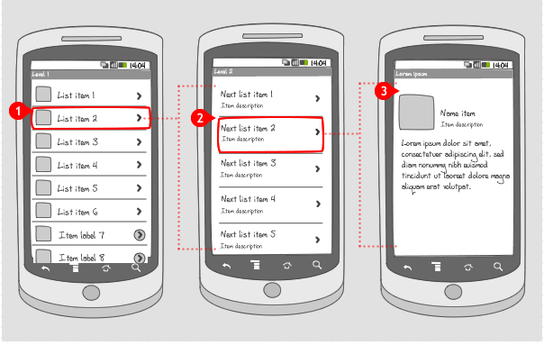
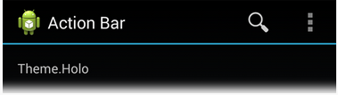
Organizing Application Navigation with Activities and Intents
Your app likely has a number of screens (each with its own Activity)
There is a close relationship between activities and intents, and application navigation
  You often see a menu paradigm used in several different ways for app navigation:
    Main menu or list-style screen
    Drill-down-list-style screen
    Click actions
    Options menus
    ActionBar-style navigation
Notes:
Main menu or list-style screen
Acts as a switch in which each menu item launches a different Activity in your application, for instance, menu items for launching the Play Game Activity, the High Scores Activity, and the Help Activity.
Drill-down-list-style screen
Acts as a directory in which each menu item launches the same Activity, but each item passes in different data as part of the Intent (for example, a menu of all database records). Choosing a specific item might launch the Edit Record Activity, passing in that particular item’s unique identifier.
Click actions
Sometimes you want to navigate between screens in the form of a wizard. You might set the click handler for a user interface control, such as a Next button, to trigger a new Activity to start and the current one to finish.
Options menus
Some applications like to hide their navigational options until the user needs them. The user can then click the Menu button on the device and launch an options menu, where each option listed corresponds to an Intent to launch a different activity.
ActionBar-style navigation
ActionBars are a functional title bar with navigational button options, each of which spawns an Intent and launches a specific Activity.

Slide 46
Working with Services
A Service (android.app.Service) can be thought of as a component that has no UI
An Android Service can be one of two things, or both
  Used to perform lengthy operations beyond the scope of a single Activity
  Can be the server of a client/server for providing functionality through remote invocation via inter-process communication
Often used to control long-running server operations
Generally, use a Service when no input is required

Slide 47
Working with Services
As a good rule of thumb, if the task
  . . . requires the use of a worker thread
  . . . might affect application responsiveness and performance
  . . . is not time sensitive to the application
  Consider implementing a service to handle the task outside the main application and any individual Activity lifecycles

Slide 48
Working with Services
Examples of when to implement a Service:
  A weather, email, or social network app
    Routinely check for updates on the network
  A game
    Downloading and processing content for the next level before the user needs it
  A photo or media app
    To keep data in sync online
    To package and upload new content in the background
  A video-editing app
    To offload heavy processing to a queue on a server in order to avoid affecting system performance
  A news application
    For “preloading” content by downloading news stories in advance, to improve performance and responsiveness

Slide 49
Receiving and Broadcasting Intents
Intents serve yet another purpose
  You can broadcast an Intent (via a call to sendBroadcast()) to the Android system, allowing any interested application (called a BroadcastReceiver) to receive that broadcast and act upon it
  Your application might send off as well as listen for Intent broadcasts
  Broadcasts are generally used to inform the system that something interesting has happened
Notes:
Broadcasts are generally used to inform the system that something interesting has happened
For example, a commonly listened-for broadcast intent is ACTION_BATTERY_LOW, which is broadcast as a warning when the battery is low. If your application has a battery-hogging service of some kind, or might lose data in the event of an abrupt shutdown, it might want to listen for this kind of broadcast and act accordingly. There are also broadcast events for other interesting system events, such as SD card state changes, applications being installed or removed, and the wallpaper being changed.

Slide 50
Receiving and Broadcasting Intents
Your application can also share information using this same broadcast mechanism
  For example, an email application might broadcast an Intent whenever a new email arrives so that other applications (such as spam filters or antivirus apps) that might be interested in this type of event can react to it

